Slide 1

Phone book application

Slide 2

Content:
Introduction
Abstract
Aim of the project
Software and Hardware details
Advantages and Disadvantages
Block Daigram
Output Results
Conclusion

Slide 3
INTRODUCTION:
Phonebook is a very simple project in C++ that can help you understand the basic concepts of functions,file handling and data structure,class.this application will teach you how to add record,display records,search record,delete record,modify record from file.
Adding new records,display records,search record,modify record,deleting the record from the phonebook records are the basic funtions which is main menu of this phonebook application.
Personal information such as name,email,mobile number,group are asked while adding a record into the phonebook.these records can be modified,displayed,searched and deleted in the file.
I have used many functions in this mini project.these functions are easy to understand as their name only signifies their respective operations

Slide 4
ABSTRACT:
The phonebook application works specifically for tracking people. The Phonebook application contains a set of basic functions for adding, searching, updating, and deleting new contacts. This mini-C phonebook design allows you to perform simple tasks in your phonebook, such as mobile phones. You can add text to the phonebook, find, edit, search, and delete.
The concept of file management and data structure is often used in almost all functions in this project. It uses functions, file management, and data structure. This application provides information on adding, viewing, modifying, receiving, and deleting data from/to files. Adding new entries, browsing them, editing and updating, searching for saved contacts, and deleting contacts in the phonebook is one of the most important services that become the main menu in the phonebook application.
When you add anything to your phone book, you will be asked for personal information such as name, gender, first name, phone number, nationality, email address, and address. You can then edit, view, search, and delete this text.

Slide 5
AIM OF THE PROJECT:
To develop an phonebook contact application using c++ programming.
This program is very useful now-a-days to store complete information under single contact number.
This program also has options to deletion and modification
of the entered contact number

Slide 6

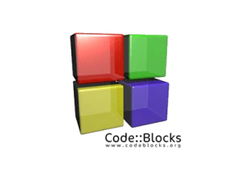
SOFTWARE AND HARDWARE DETAILS:
This PhoneBook Application code is implemented by using following compliers
Turbo C++
Code::blocks
Online C++ complier

Slide 7
ADVANTAGES AND DISADVANTAGES:
It becomes easy for the user to store complete information(i.e e-mail id,address)about his contact.
It is easy for the user to just search his required contact number by just typing name of the contact.
Sometimes it becomes difficult to store more contacts.
It becomes even difficult to store contacts with two or more contact numbers.

Slide 8
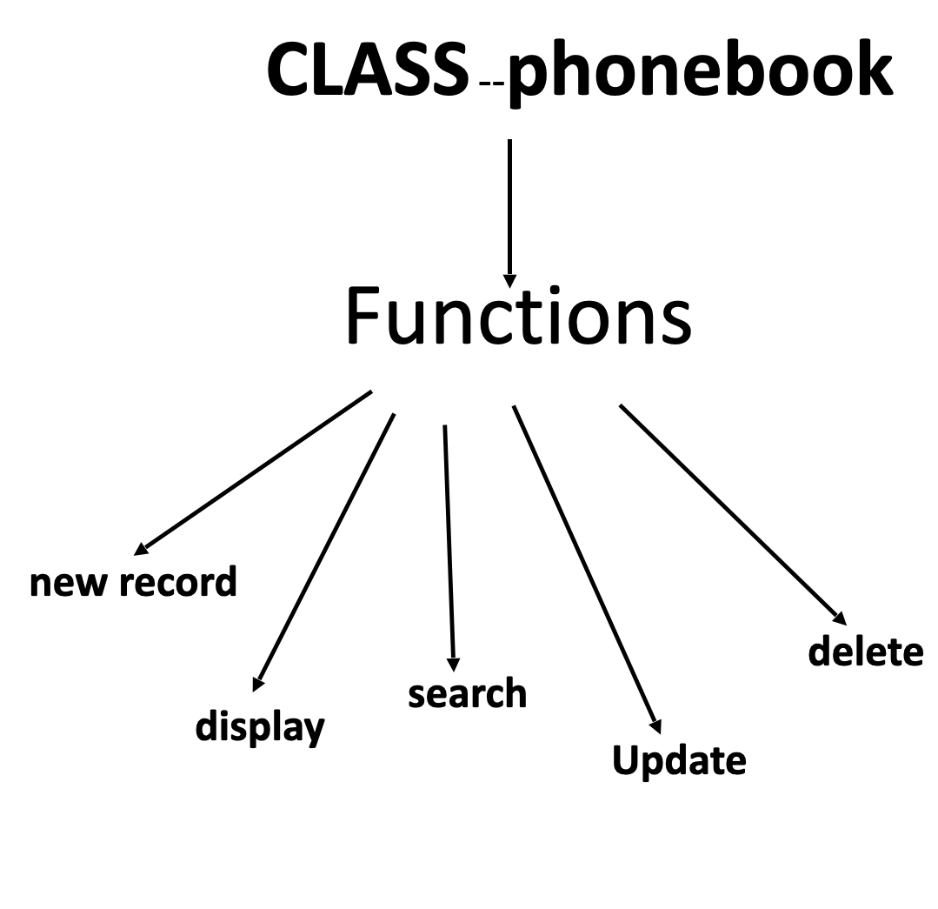
Block diagram:

Slide 9
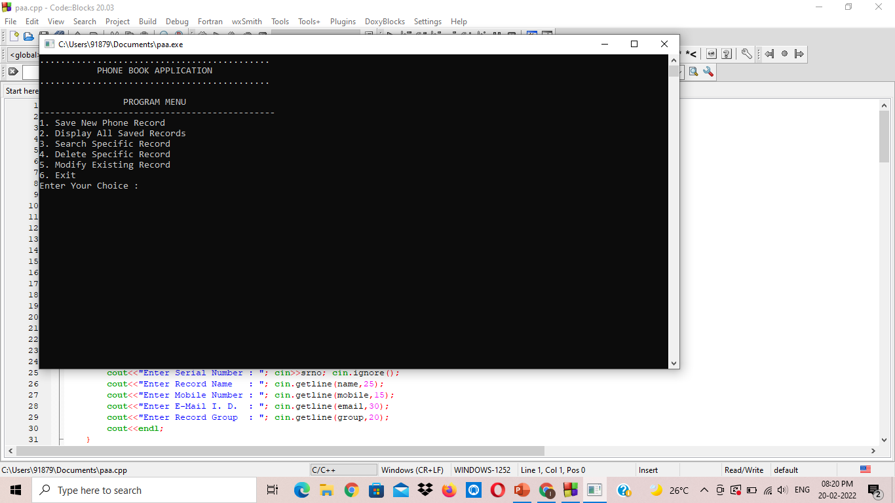
Output result:

Slide 10
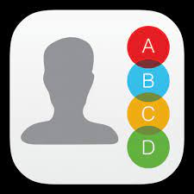
Conclusion:
The application program has been successfully implemented using C++ programming.This application works for other functions that make it easy to search, delete,edit and add contact and modify them .

Slide 11
THANK YOU…

